Slide 1
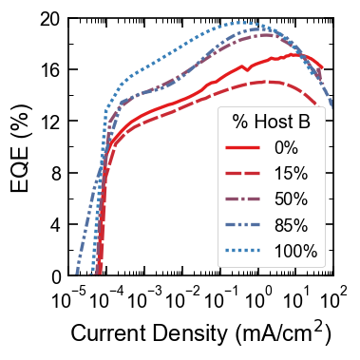
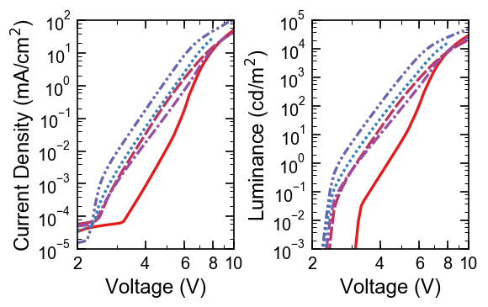
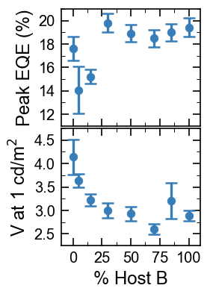
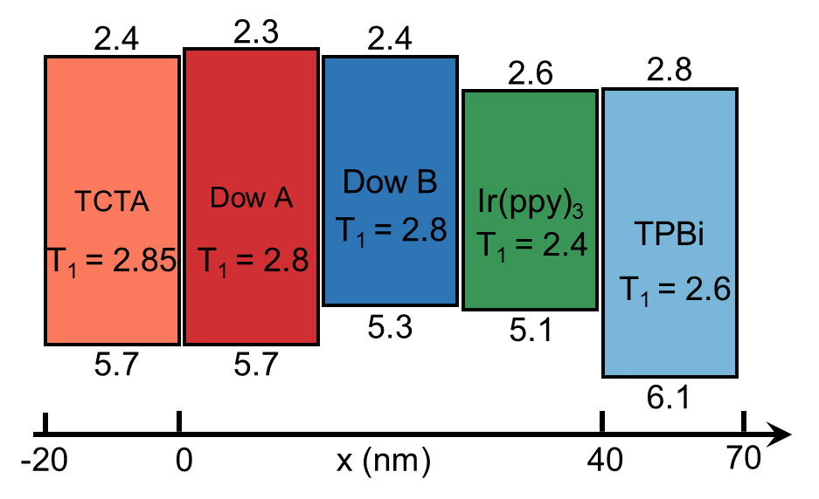
Efficiency, lifetime, and energy levels
Figure 1. Efficiency and Energy Levels
(a)
(c)
(d)
(a) External quantum efficiency (EQE) as a function of current density for various Host A and Host B blend ratios. (b) Peak EQE and turn-on voltage (at 1 cd/m²) as a function of host compostion. (c) and (d) Current density and luminance as a function of voltage for various host compositions. (e) Energy level schematic illustrating the HOMO, LUMO, and triplet energy levels for the materials used in these devices. The x-axis denotes the layer thicknesses used in these devices, as a function of distance from the HTL/EML interface.
(b)
(e)

Slide 2
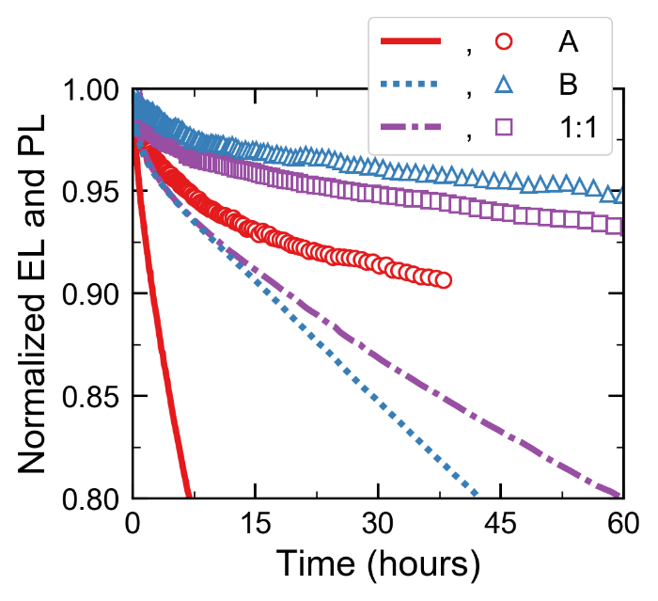
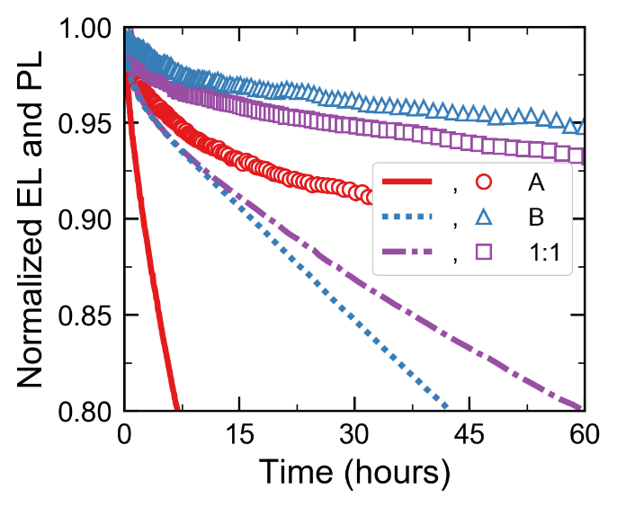
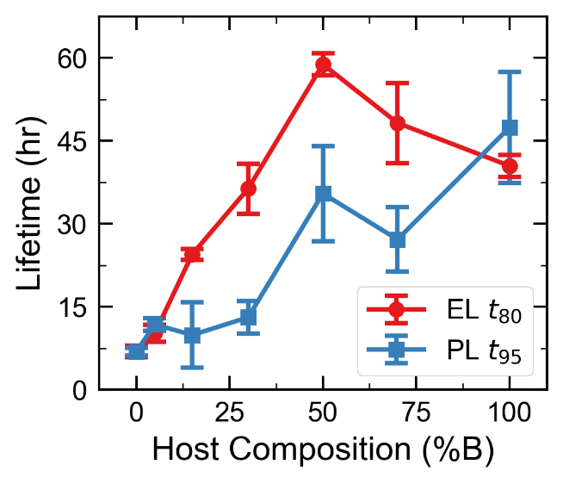
Figure 2. 10 nm EML Lifetimes
(a)
(a)
(b)
(b)

Slide 3
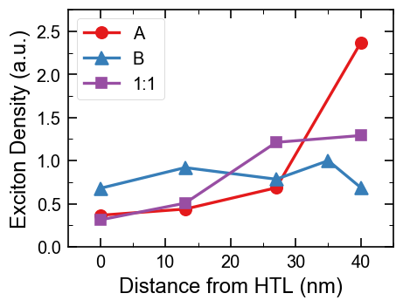
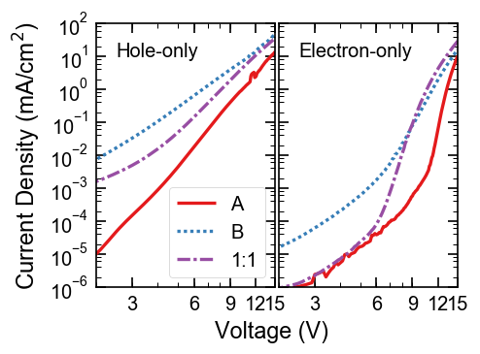
(a)
(c)
Al 100 nm
MoOx 10 nm
TCTA 30 nm
Dow Hosts:Ir(ppy)₃ (15%) 100 nm
TCTA (30 nm)
ITO
(b)
(d)
LiF 1 nm/Al 100 nm
TPBi 30 nm
Dow Hosts:Ir(ppy)₃ (15%) 100 nm
TPBi (30 nm)
LiF 1 nm/Al 10 nm
ITO
Electron Only

Slide 4
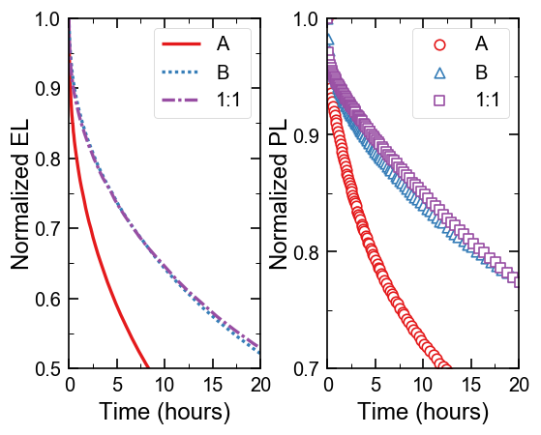
Figure 4. 10 nm EML Lifetimes
(a)
(b)

Slide 5
LiF + Al
TPBi 30 nm
Host:Ir(ppy)₃ (15%) 40 nm
TCTA 20 nm
2.3
AQ1250/ITO/Glass
2.4
2.4
TCTA
Dow A
Dow B
2.6
2.8
Ir(ppy)₃
TPBi
T₁ = 2.8
T₁ = 2.4
T₁ = 2.85
T₁ = 2.8
T₁ = 2.6
5.3
5.1
5.7
5.7
6.1
-20
0
x (nm)
40
70

Slide 6
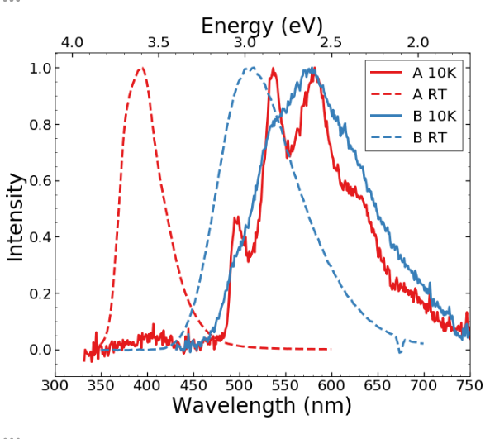
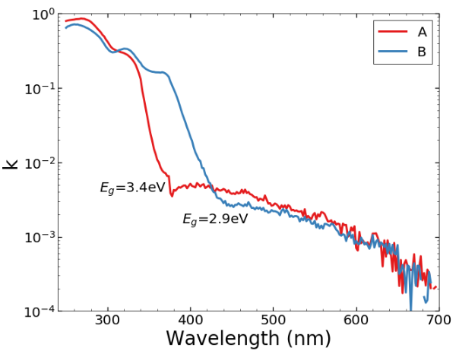
SI: Host properties
(a)
(b)

Slide 7
SI: RZ measurement spectra

Slide 8
SI: 10 nm M-EML Efficiencies

Slide 9
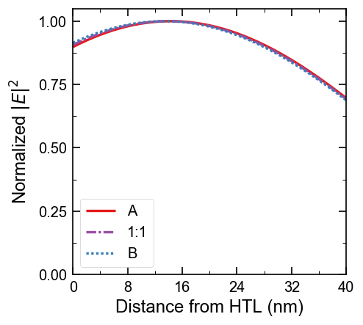
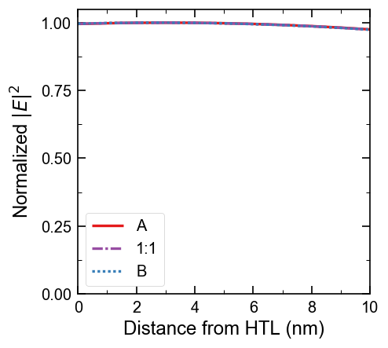
Electric field profiles

Slide 10
SI: 5% Ir(ppy)₃ Devices

